Slide 1
MODULE-01

Slide 2


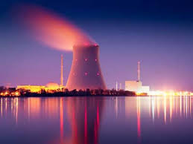
WORK & ENERGY
Work
Energy

Slide 3
WORK & ENERGY
Concept of work
Unit of work (S.I & CGS)
Define 1J

Slide 4

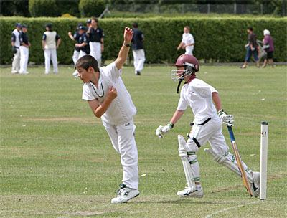

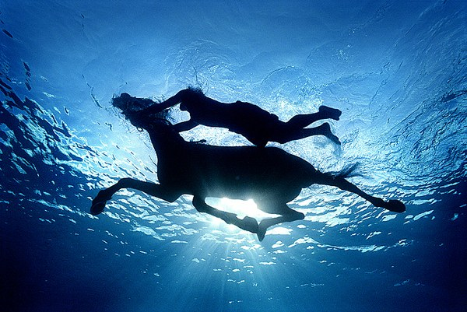

Slide 5
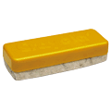
1. Define work.
Duster
Force
A
Displacement
B
Work is said to be done whenever a force acts on a object and it displaces in the direction of applied force.
2.How work ,force and displacement are related to each other.
∴ Work
= Force
× Displacement
W
= F
× s

Slide 6
MODULE-02

Slide 7
3. Write M.K.S & C.G.S unit of work, if
Work = force x displacement
M.K.S
1
joule
1
1
meter
=
newton
×
(J)
(N)
1 dyne
(m)
4. Define 1 J
1 cm
The amount of
done when a
Displaces it
Work
=
Force
×
Displacement
of 1N
through a distance of 1m
Along it’s own direction.
is said to be 1J.
acts on
an object
C.G.S
erg
=
1
dyne
1
× centimeter
1
1 erg
Define 1 erg (classroom activity)

Slide 8
A Force of 5 N is acts on an object and the object is displaced to a distance of 2 m in the direction of the force. Find the work done?
1
Given :
Force(F)
= 5 N
Distance travelled by object(s)
= 2 m
To find :
Work done(W)
= ?
Force applied 5N
Object displaces by 2m
W
= F × s
Formula :
Solution :
W
= F × s
∴
W
= 5
× 2
∴
W
= 10 J
Ans :
Thus the work done in given condition is 10 J.

Slide 9
MODULE-03

Slide 10
WORK & ENERGY
Does energy and work has same unit
Positive work
Negative work
Neutral work

Slide 11
Does energy and work has same units?
YES
UNITS
S.I
C.G.S
joule(J)
erg
{N-m}
{dyne-cm}
Relation between S.I and C.G.S units of energy :
= 1 N
x
(1 N = 10⁵ dyne
,1 m = 100 cm)
1 joule
1 m
= 10⁵ dyne
x 10² cm
= 10⁷ dyne - cm
1 joule = 10⁷ erg

Slide 12
How does the angle between the force applied and the
displacement of an object effects the nature of work done
Product of the given factors are of two types
Dot (·)
Cross (×)
A dot product is a cos product
A cross product is a sin product
example, a.b = ab cos θ
a × b = ab sin θ
a and b are the given vectors and ‘θ’ is the angle between the vectors a and b
Where cos and sin are the trigonometric ratios
b
θ
a

Slide 13
MODULE-04

Slide 14
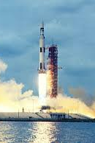
Thus
Work
= F.s
parallel
W
= F s cos θ
Case i.
When ‘F’ and ‘s’ are in the same direction i.e., F II s and ‘θ’ = 0⁰
W
= F s cos 0⁰
W
= F s
(1)
Since FIIS so ‘θ’ is 0⁰
F
s
W
= F s
[cos 0⁰ = 1]
Thus work done is positive.
Case ii.
When Force ‘F’ and displacement ‘s’ are in opposite direction i.e. ‘θ’ is 180⁰
S
W
= F s cos θ
180⁰
W
= F s cos 180⁰
[cos180⁰ = —1]
W
= F s
(-1)
F
W
= —F s
Thus work done is negative.

Slide 15
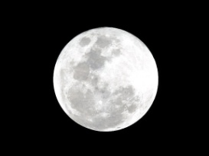
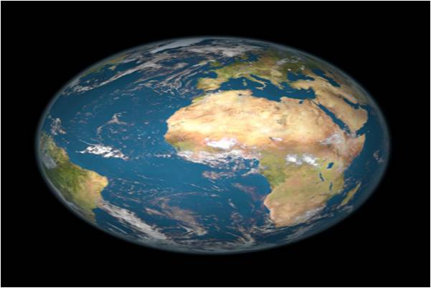
Case iii.
S
When Force ‘F’ and displacement “s’’ are normal to each other i.e., θ = 90⁰
90⁰
W
= F s cos θ⁰
F
W
= F s cos 90⁰
W
= F s
(0)
cos 90⁰ = 0
W
= 0
Thus work done is neutral or no work is done when the force applied and displacement are normal to each other.

Slide 16
MODULE-05

Slide 17
WORK & ENERGY
Numerical based on neutral work
Types of energy

Slide 18
A mass of 10 kg is at a point A on the table. It moved to a point B. If the line joining A and B is horizontal, what is the work done on the object by the gravitational force? Explain your answer.
1
Given :
Mass (m) =
10 kg
S
Displacement ( AB ) is horizontal
A
B
To find :
Work done on the object by the gravitational force = ?
F
= F S
cos 90⁰
Formula :
Work done
Solution :
Force of gravitation acts downwards
The angle between the force and displacement is 90⁰
Work done
= F S
cos 90⁰
= F S
[cos 90⁰⁼ 0]
×
0
= 0 J
Ans :
Thus work done is zero.

Slide 19
A pair of bullocks exerts a force of 140 N on a plough. The field
being ploughed is 15 m long. How much work is done in ploughing the length of the field?
2
Given :
Force (F) =
140 N
Displacement (s)
= 15 m
To find :
Work done = ?
Formula :
Work done
= F × S
Solution :
Work done = F × S
= 140 × 15
= 2100 J
Ans :
Thus work done in ploughing the field is 2100 J

Slide 20
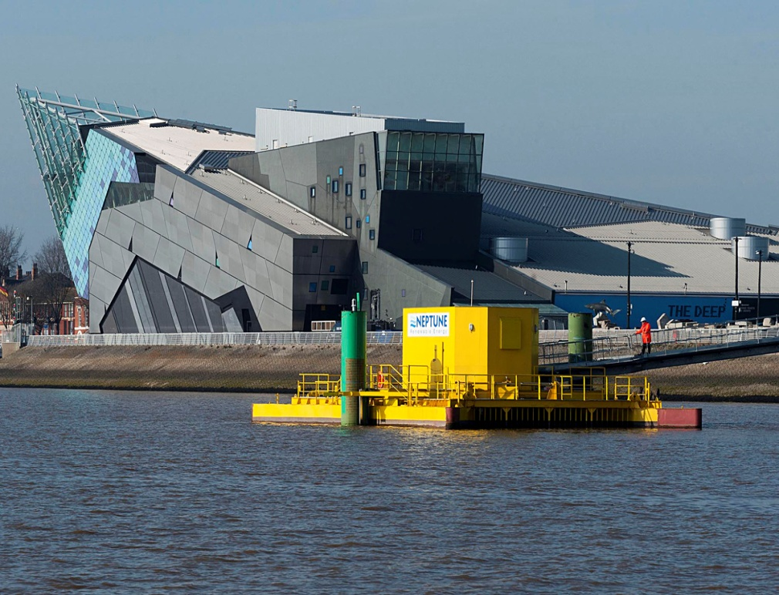
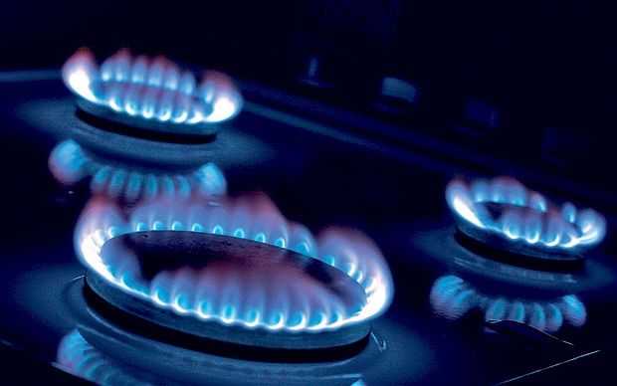
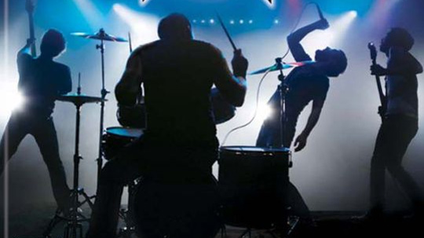
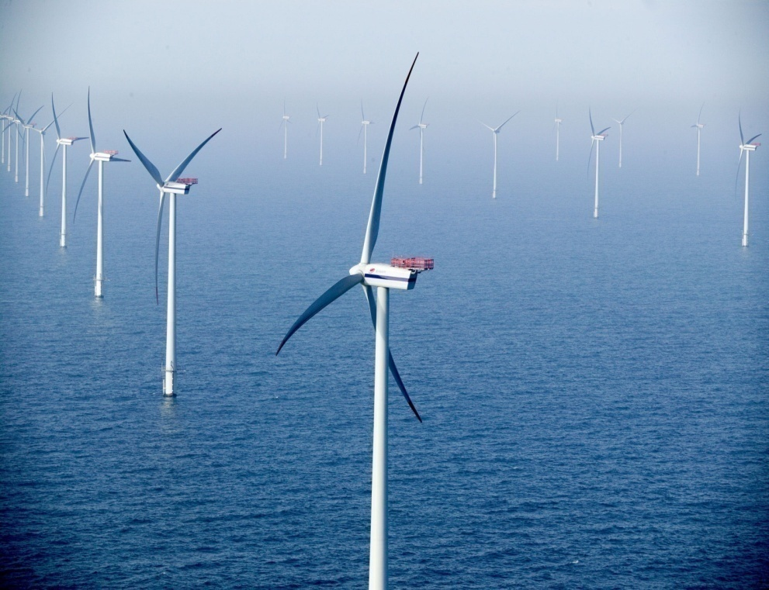

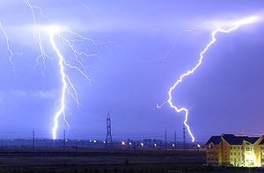
Types of ENERGY
Define energy.
Heat Energy
It is the capacity to do work.
Wind Energy
Sound Energy
Electrical Energy
Light Energy
Tidal Energy

Slide 21
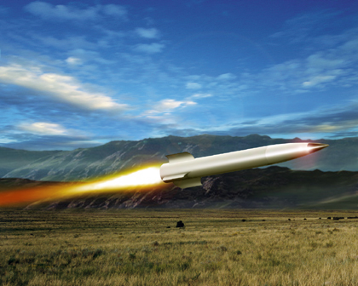
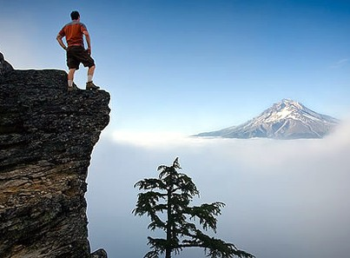
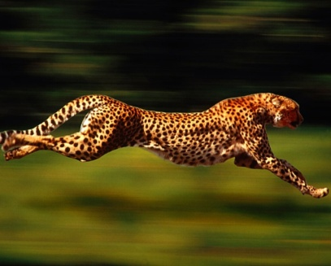
Mechanical Energy
Kinetic Energy
Potential Energy
The energy possessed by virtue of it’s motion
The energy possessed by virtue of it’s position or shape.
H
E
I
G
H
T
REST
MOTION

Slide 22
MODULE-06

Slide 23
WORK & ENERGY
Work done in lifting an object.
Work done against gravity is independent of path followed by the object.

Slide 24
Derive an expression for the work done in lifting an object of mass ‘m’ to a height ‘h’.
Let us consider an object of mass ‘m’.
B
Thus the work done in lifting the object of mass ‘m’ to a height ‘h’.
Work done
×
Displacement
= Force
h
= F
×
s
ma
= ma
h
Height – ‘h’
W
= mgh
m
A
Acceleration due to gravity (a) = g
Thus the work done is given by the equation
W
= mgh
Where
W =
work done
m =
Mass of the object
g =
Acceleration due to gravity
h =
Height to which the object is raised
This work done is stored in the form of Gravitational potential energy.

Slide 25
A porter lifts a luggage of 15 kg from the ground and puts it on his head 1.5 m above the ground. Calculate the work done by him on the luggage. (g = 10ms⁻²)
1
Given :
Mass of luggage (m)
= 15 kg
Displacement (s)
= 1.5 m
To find :
Work done (W)
= ?
F
= m × g
Formula :
W
= F × s
Solution :
F
= m × g
W
= F × s
∴
F
= 15
× 10
∴
W
= 150
× 1.5
∴
F
= 150 N
∴
W
= 225 J
Ans :
The work done is 225 J.

Slide 26
Does the gravitational potential energy of the body depend
on the path along which the body is moved ?
Thus the work done against gravity is independent of the path along which the body is moved & it depends only on the initial & final positions of the body.
Case i
B
E
D
Case ii
h
h
B
C
The net displacement from initial & final position (h)
A
A
Work done in moving the body along the path AB to rise it to a height ‘h’
Work done in moving the body along the path AE to rise it to a height ‘h’
W
=
F × S
W
=
F × S
=
h
=
h
mg
mg
W
=
P.E
W
=
P.E

Slide 27
An object of mass 12 kg is at a certain height above the ground.
If the potential energy of the object is 480 J, find the height at which the object is with respect to the ground. Given, g = 10 m s^{–2}.
1
Given :
Mass (m)
= 12 kg
Potential Energy (P.E.)
= 480 J
g
= 10 m s^{–2}
To find :
Potential energy
= ?
Formula :
Potential energy
= mgh
Solution :
Potential energy
= mgh
∴
480
= 12
× 10
× h
480
∴
h
=
120
∴
h
= 4 m
Ans :
The object is at the height of 4 m.

Slide 28
Find the energy possessed by an object of mass 10 kg when it is at a height of 6 m above the ground. Given, g = 9.8 m s^{–2}.
2
Mass (m)
= 10 kg
Given :
Displacement (h)
= 6 m
(g)
= 9.8 m s^{–2}
To find :
Potential energy
= ?
Formula :
Potential energy
= mgh
Solution :
Potential energy
= mgh
= 10
× 9.8
× 6
= 588 J
Ans :
The potential energy is 588 J.

Slide 29
MODULE-07

Slide 30
WORK & ENERGY
Work done in terms of change in K.E
To find the work done by the force in case of change in K.E

Slide 31
Derive an expression of work done in terms of change in kinetic energy
Work
×
=
Force
displacement
=
u²
+
v²
2as
=
F
×
S
2as
=
v²
-
ma
u²
F =
v²
-
s
=
u²
v²
-
u²
m
a
×
=
2a
2a
The work done is equal to the kinetic energy when an object starts from rest.
1
=
m
(
v²
-
u²
)
2
1
1
1
m
v²
0 J
∴K.E
=
mv²
(when u=0ms⁻¹)
=
-
m
u²
2
2
2
=
-
K.E _{(final)}
K.E _{(initial)}
Thus ,
Work done
= Change in kinetic energy

Slide 32
An object of mass 15 kg is moving with a uniform velocity of
4 m s^{–1}. What is the kinetic energy possessed by the object?
1
Mass (m)
= 15 kg
Given :
Velocity (v)
= 4 m s^{–1}
To find :
K.E.
= ?
1
Formula :
K.E.
=
mv²
2
1
Solution :
K.E.
=
mv²
2
1
=
× 15
× (4)²
2
1
2
=
× 15
× 4 × 4
2
1
=
15 × 2 × 4
Ans :
The kinetic energy of the object is 120 J.
=
120 J

Slide 33
Certain force acting on a 20 kg mass changes its velocity from 5 m s⁻¹ to 2 m s⁻¹. Calculate the work done by the force.
2
Given :
Mass (m)
= 20 kg
1
=
× 20
[(2)² – (5)²]
Initial velocity (u)
= 5 ms⁻¹
2
Final velocity (v)
= 2 ms⁻¹
1
=
× 20
[4 – 25]
To find :
Work done (W)
= ?
2
1
10
F
= m × g
=
10 × (– 21)
Formula :
∴
W
=
– 210 J
Solution :
Work done(W)
= Change in K.E
= K.E_{(final)}
– K.E_{(initial)}
Ans :
1
1
The work done by the force is 210 J and the negative sign indicates the applied force is retarding in nature.
=
mv²
–
mu²
2
2
1
=
m
(v² – u²)
2

Slide 34
MODULE-08

Slide 35
Give reason kinetic energy is always positive.
Formula : ½ mv²
Mass is always positive.
‘v’ can be either positive or negative but v² is always positive.
K.E exists in only one form - POSITIVE

Slide 36
Calculate the work required to be done to stop a car of 1500 kg moving at a velocity of 60 km/h.
3
Given :
Mass of the car (m)
= 20 kg
1
Initial velocity (u)
= 60km/h
∴
W
=
–
mu²
2
10
5
50
1
50
2
m s⁻¹
= 60 ×
=
ms⁻¹
∴
W
=
–
× 1500
×
18
3
2
3
3
250
Final velocity (v)
= 0 ms⁻¹
500
1
50
50
The work required to be done to stop the car.
×
×
To find :
=
–
× 1500
2
3
3
F
= m × g
Formula :
250
× 50
× 50
=
–
Solution :
Work done(W)
= Change in K.E
3
= K.E_{(final)}
– K.E_{(initial)}
−625000
=
1
1
3
∴
W
=
mv²
–
mu²
∴
W
= −208333.3 J
2
2
1
1
Ans :
Thus the work done to stop the moving car is 208333.3 J
∴
W
=
m
(0)²
–
mu²
2
2

Slide 37
What is the work to be done to increase the velocity of a car from 30 km h^{–1} to 60 km h^{–1} if the mass of the car is 1500 kg?
4
Given :
Initial velocity (u)
= 30 km h^{–1}
1
1
5
5
25
=
mv²
–
mu²
m s⁻¹
2
2
= 30 ×
=
ms⁻¹
18
3
1
3
=
m
(v² – u²)
Final velocity (v)
= 60 km h^{–1}
2
10
5
1
750
50
²
25
²
50
×
–
m s⁻¹
=
× 1500
= 60 ×
=
ms⁻¹
18
2
3
3
3
3
1
Mass (m)
= 1500 kg
2500
625
=
×
–
750
To find :
Work done (W)
= ?
9
9
1
2500 - 625
K.E.
=
mv²
×
Formula :
=
750
2
9
Solution :
Work done(W)
= Change in K.E
250
625
×
1875
156250 J
Ans :
=
750
=
= K.E_{(final)}
– K.E_{(initial)}
The work done to increase the velocity of the car is 156250 J
9
3
1

Slide 38
MODULE-09

Slide 39
WORK & ENERGY
Verification of Law of conservation of energy in case of a free fall.

Slide 40




In a freely falling body total energy remains constant at each point.
u = 0
At point A,
At point B,
At point C,
Initial velocity is 0
A
m
According to 3rd equation of motion
K.E
= ½ mv²
= 0
According to 3rd equation of motion
P.E
= mg (h – x)
Consider a body of mass 'm' at height 'h'
P.E
= mgh
But Total Energy at every point always remains CONSTANT
v² = u² + 2as
v² = u² + 2as
T.E
= P.E + K.E
T.E
= P.E + K.E
u = 0,
a = g,
s = h
$$x$$
u = 0,
v = v₁,
a = g,
s = x
+ mgx
= mg( h - x )
Hence on subs. we get,
= mgh + 0
Hence on substituting we get,
Displacement is x
v²
= 0²
= 2gh
Initial velocity is zero
= mgh - mgx + mgx
+ 2(g)
(h)
v₁
T.E = mgh
Final velocity is v₁
Acceleration will be acceleration due to gravity
KINETIC ENERGY increases as ball moved from point
A→B→C
K.E
= ½ mv²
POTENTIAL ENERGY decreases as ball moved from point
A→B→C
v₁²
= 0²
+ 2(g)
(x)
T.E = mgh
B
h
m
Final velocity is v₁
v₁² = 2gx
Hence total energy at A and B are the same.
Substituting v² = 2gh,
Now the body falls from point A to B through a distance $x$
K.E
= ½ m
× 2gh
K.E
= ½ mv₁²
K.E
= mgh
Substituting v₁² = 2gx, in formula of K.E
On the ground level h = 0
h - x
P.E
= mgh = 0
K.E
= ½ m
× 2g(x)
T.E
= P.E + K.E
K.E
= mgx
= 0 + mgh
C
T.E = mgh
At B above the ground level (h - x)

Slide 41
Show that energy in case of free fall of a body is conserved.
Potential energy of the object at ‘A’
Position ‘A’
The object travels a distance ‘x’ from the top
P.E
= mgh J
1
At rest v = 0 ms^{–1}
K.E
=
mv²
2
x
= 0 J
The object is at a height ‘h’ from the surface.
Position ‘B’
Thus
h
Total energy (T.E)_{A} =
P.E
+
K.E
= mgh
+
0
h-x
T.E_{A}
= mgh
Height of the object at position ‘B’ from the surface of the earth
= (h–x)
P.E of the object at point ‘B’
P.E_{(B)}
= mg
(h–x)
–
P.E_{(B)}
= mgh
mgx
1
To find K.E of the object at point ‘B’ K.E
=
mv²
2

Slide 42
To find K.E at point ‘B’ let’s find ‘v’ first
The object travels a distance ‘x’ from the top
V²
= u²
u = 0 ms-1 at rest
+
2g s
V²
= 0
+
2g x
s = x m
x
V²
= 2g x
1
∴ K.E
=
mv²
v² = 2gx
2
1
=
(2gx)
m
2
= mgx
Thus
T.E_{(B)}
= P.E_{(B)}
+
K.E_{(B)}
= (mgh – mgx)
+
mgx
= mgh
–
mgx
mgx
+
T.E_{(B)}
= mgh

Slide 43
MODULE-10

Slide 44
To find K.E at point ‘C’ let’s find ‘v’ first
Position ‘A’
V²
= u²
u = 0 ms-1 at rest
Distance travelled is equal to the height of the object from point ‘A’
+
2g s
V²
= 0
+
2g h
s = h m
V²
= 2g h
h
1
∴ K.E
=
mv²
v² = 2gh
2
1
=
(2gh)
m
Position ‘C’
2
= mgh
Thus
K.E_{(c)}
= mgh
Now
Potential energy at point ‘C’ P.E_{(C)}
= mgh
= mg
×
0
Potential energy at point ‘C’ P.E_{(C)}
= 0 J

Slide 45
Thus total energy at point ‘C’ T.E_{(C)}
= P.E_{(C)}
+
K.E_{(C)}
= 0
+
mgh
T.E_{(C)}
= mgh
Thus the total energy of the body is constant and is equal to mgh.
This verifies the law of conservation of energy.

Slide 46
MODULE-12

Slide 47
WORK & ENERGY
Law of conservation of energy

Slide 49
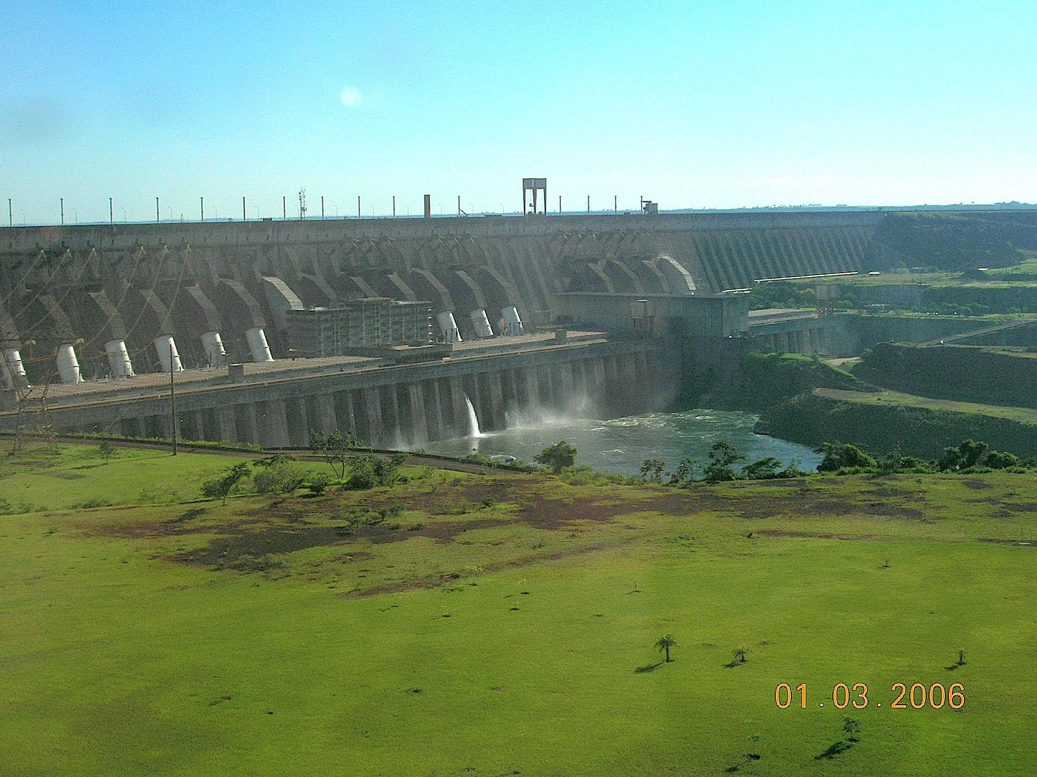


ENERGY FROM FLOWING WATER
High Rise dams are constructed to obstruct the flow of water
Water at high level contain potential energy
Water from high level in dam is carried through pipes thus potential energy of water changes kinetic energy
(HYDROELECTRIC POWER PLANT)
Turbines are connected to generator
TURBINES
GENERATOR
Mechanical energy to Electrical energy
Kinetic energy to Mechanical energy

Slide 50
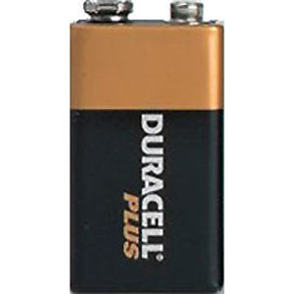
Law Of Conservation Of Energy
Energy can neither be created nor destroyed. It changes from
one for to another.
The total amount of energy in the universe always remains constant.
Heat Energy
Light Energy
Electrical Energy
Chemical Energy

Slide 51
MODULE-13

Slide 52
WORK & ENERGY
Electrical power
Commercial unit of electrical energy
Define 1J

Slide 53
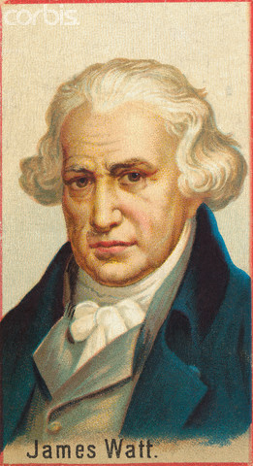
POWER
Power is defined as the work done per unit time
Work done
Power =
Power is a scalar quantity
Time
Units
S.I.
C.G.S.
1
Joule
Erg
1
watt =
1
Sec
Sec
(W)
1 watt
Power developed or used is one watt
when one joule of work is done in 1 sec

Slide 54
Higher units
(1 kilowatt =
kilowatt
1000 watt )
Commercial unit of energy
Work
Power =
Time
Watt changes to kW
Second changes to Hour (hr)
Energy Used
Power =
Time
Energy Used =
Power X Time
ENERGY USED =
kW-hr
1 unit
Horsepower
1 horsepower =
746 watt

Slide 55
MODULE-14

Slide 56
WORK & ENERGY
Electrical energy used,
Heat energy = Power x time
H = P t

Slide 57
A bulb of 40 W is used for 12.5 h each day for 30 days. Calculate the electrical energy consumed.
1
Given :
Power of the lamp (P)
= 40 W
Time for which bulb
is used for each day
= 12.5 h
To find :
Energy consumed (H)
= ?
H
= P × t
Formula :
Solution :
H
= Power in watt
× Time in hours
∴
H
= 40
× 12.5
500
∴
H
= 500 Wh
=
kWh
= 0.5 kWh
1000
Electrical energy consumed in 30 days
= 0.5 kWh
× 30 Wh
= 15 kWh
Ans :
The electrical energy consumed by the bulb for 30 days is 15 kWh

Slide 58
An electric iron is rated at 750 W, 230 V. Calculate the electrical energy consumed by the iron in 16 hours.
2
Given :
Power (P)
= 750 W
=
750
kW
= 0.75 kW
Time (t)
= 16 h
1000
To find :
Energy used (H)
= ?
H
= P × t
Formula :
Solution :
H
= Power
× Time
= 0.75
× 16
= 12 kWh
Ans :
The electrical energy consumed by the iron in 16 hours is 12 kWh

Slide 59
An electric bulb of 60 W is used for 6 h per day. Calculate the ‘units’ of energy consumed in one day by the bulb.
3
Given :
Power (P)
= 60 W
= 0.06 kW
Time (t)
= 6 h
To find :
Energy
= ?
H
= P × t
Formula :
Solution :
Energy
= Power
× Time taken
= 0.06
× 6
= 0.36 kW h
∴
Energy
= 0.36 units
Ans :
The energy consumed by the bulb is 0.36 ‘units’.

Slide 60
MODULE-15

Slide 61

Work , Energy and Power
Relation between commercial & SI unit of energy
Numerical based on Electrical Power

Slide 62
Relation between Commercial & S.I. unit of work
WORK = Power X Time
S.I. unit -
Joule =
Watt x Second
Commercial unit = kW-hr
1kW - hr
1ooo W
х 3600 s
=
1kW - hr
36 x 10⁵ W.s
=
kW - hr
1
=
36 x 10⁵ JOULE
1 kW – hr = 3.6 x 10⁶ J

Slide 63
A certain household has consumed 250 units of energy during a month. How much energy is this in joules ?
1
Given :
Unit of energy used
= 250 units
1 kW =
1000 W
To find :
Energy used in joules
= ?
1 h =
3600 sec.
Formula :
1 unit
= 1 kWh
∴ 1kWh =
3.6 × 10⁶ J
Solution :
1 unit of energy
= 1kWh
= 3.6
× 10⁶J
250 units of energy
=
250
× 3.6
× 10⁶
=
25
× 3.6
× 10⁷ J
=
90
× 10⁷ J
=
9 × 10⁸J
Ans :
Thus the amount of energy used in 250 units is 9 × 10⁸J

Slide 64
MODULE-16

Slide 65
Work , Energy and Power
Numerical based on Electricity bill calculation

Slide 66
An electric heater is rated 1500 W.
How much energy does it use in 10 hours?
1
Given :
Electrical power of the heater
= 1500 W
= 1.5 kW
Time
= 10 hours
Energy used in kWh
= ?
1500
To find :
=
1.5kW
1000
Formula :
Energy used =
Power
×
Time
Solution :
Energy used
= Power
× Time
= 1.5
× 10
= 15 kWh
Ans :
Energy used in 10 hours is 15 kWh

Slide 67
Find the energy in kWh consumed in 10 hours by 4 devices of power 500 W each.
2
Given :
Power of each device
= 500 W
No of device
= 4
Total power
= 4
× 500
= 2000 W
= 2 kW
To find :
Energy used
= ?
Formula :
Energy used
= Power × Time
2000
=
2kW
Energy used
= Power
1000
Solution :
× Time
= 2
× 10
= 20 kWh
Ans :
The energy consumed by four devices of 500 W each operated for 10 hours a day is 20 kWh.

Slide 68
MODULE-17

Slide 69
Work , Energy and Power
Numerical based on Electricity bill calculation

Slide 70
WORK & ENERGY
TYPE -A
VSA ,1 Mark questions
For section- A from Q. No. 1 - 3

Slide 71
A car and track are moving with the same velocity of 60 km/hr. which of them has more kinetic energy
1
Ans :
K.E is directly proportional to m
Thus the truck has more K.E
Define 1 joule of work .
2
Ans :
1 joule – The amount of work done when a force of 1N acts on an object displace it to a distance of 1m along the direction of force , the magnitude of work is said to be 1J.

Slide 72
Seema tried to push a heavy rock of 100 kg for 200 sec but could not move it. Find the work done by Seema at the end of 200s.
3
Ans :
Since displacement is zero
Thus work done is zero.
How much work is done by a weight lighter when he holds a weight of 80kg on his shoulders for two minutes?
4
Ans :
Since displacement is zero
Thus work done by the weight lifter is zero

Slide 73
When displacement is in a direction opposite to the direction of applied , what is the type of work.
5
When Force ‘F’ and displacement ‘s’ are in opposite direction i.e. ‘θ’ is 180⁰
Ans :
W
= F s cos θ
W
= F s cos 180⁰
[cos180⁰ = —1]
W
= F s
(-1)
W
= – F s
S
Thus work done is negative.
180⁰
F

Slide 74
Write the observed energy transformation that takes place at hydroelectric power plant.
6
Ans :
P.E.
K.E.
M.E.
Electrical energy
How many joules makes 1 kilowatt hour?
7
kWhr
=
3.6
Ans :
×
10⁶J

Slide 75
When a player hits a football it moves along a curved path and then falls to the ground. Calculate the work done by the force of gravity on the football.
8
Ans :
When a player hits a football it rises up along the curve path and then falls to the ground then the work done by the force of gravity is,
h
=
W
=
mgh
0
m
=
mg
×
0
Thus, no work is done as displacement is zero.

Slide 76
MODULE-18

Slide 77
WORK & ENERGY
TYPE -B
SA-I , 2 Mark questions
For section- A from Q. No. 4 - 7
Work done
Power =
Time

Slide 78
A man weighing 500 N carries a load of 100 N up a height of stairs 4 m high in 5 seconds. What is his power ?
1
Given :
Total Weight
= Weight of man
+ Weight of the load
= (500 + 100)
120
= 600 N
600 × 4
Force (F)
∴
Power
=
= 600 N
5
Displacement (s)
= 4m
1
Weight
=
Force
= 120 × 4
= 480 W
Time (t)
= 5 s
Ans :
The power of the man is 480 W
To find :
Power of the man
= ?
Work done
Formula :
Power
=
time
Work done
Solution :
Power
=
time
F × s
=
t

Slide 79
MODULE-19

Slide 80
WORK & ENERGY
SA-I, 2 Mark questions
For section- A from Q. No. 4 - 7
P.E
Power =
Time

Slide 81
A boy of mass 50 kg runs up a staircase of 45 steps in 9 s. If the
height of each step is 15 cm, find his power. Take g = 10 m s^{–2}.
1
Given :
Mass of boy (m)
= 50 kg
Height of staircase (h)
= Height of each step × No . of steps
= 15 × 45
= 675 cm
=
675
= 6.75 m
100
Time taken to climb (t)
= 9 s
Acceleration due to gravity (g)
= 10 m s^{–2}
To find :
Power (P) = ?
m × g × h
W
=
Ans :
The power of the boy is 375 W
Formula :
P =
t
t
50 × 10 × 6.75
=
P.E.
Work done = P.E.
Solution :
P =
9
t
3375
=
=
375 W
9

Slide 82
Calculate the power of a pump which can lift 100 kg of water to store it in a water tank at a height of 19 m in 25 sec.
[Take g = 10 m s⁻²]
2
Given :
Mass (m)
= 100 kg
mgh
∴
Power
=
Height (h)
= 19m
t
time (t)
= 25 sec
4
100
× 10
× 19
g
= 10ms⁻²
=
25
1
To find :
Power of the pump
= ?
=
4 × 10 × 19
=
40 × 19
Work done
Work done in lifting water stored in the from of P.E
Formula :
Power
=
=
760 W
time
Work done
Ans :
Thus the power of the pump is 760W
Solution :
Power
=
time
P. E.
∴
Power
=
time

Slide 83
MODULE-20

Slide 84
Two girls, each of weight 400N, climb up a rope through a height of 8m. We name one of the girl as ‘A’ & other as ‘B’. Girl ‘A’ takes 20 seconds while ‘B’ tales 50 seconds to accomplish this take. What is the power expended by each girl ?
1
Given :
Weight of girls (mg) = 400N
4
400
×
8
Height (h) = 8m
=
Time taken by girl A (t_{a}) = 20s
1
20
Time taken by girl B (t_{b}) = 50s
=
40
×
4
=
160 W
To find :
Power (P_{A}) and (P_{B})= ?
Power_{(B)} =
P.E
mgh
Work done = P.E.
=
Work done
Time
t_{b}
Formula :
Power =
8
Time
400
×
8
=
Work done
mg = Weight
50
Solution :
Power_{(A)} =
1
Time
=
8
×
=
64 W
8
P.E
mgh
=
=
Time
t_{a}
Ans :
Power expended by girl A is 160 W and girl B is 64 W.

Slide 85
MODULE-21

Slide 86
WORK & ENERGY
SA –I , 2 Mark questions
For section- A from Q. No. 4 - 7
v² = u² + 2gs

Slide 87
If a 5kg ball is thrown upwards with a speed of 100ms⁻¹
then calculate the maximum height attained by it
(take g = 10ms⁻²).
1
Given :
Mass (m) = 5kg
i) v = u + gt
Initial speed (u) = 10ms⁻¹
1
Final velocity (v) = 0ms⁻¹
ii) s =
ut +
gt²
2
g = 10ms⁻²
iii) v² = u² + 2gs
To find :
maximum height attained (s) = ?
Formula :
v²
=
u²
+
2gs
5
100
Solution :
v²
=
u²
+
2gs
s =
1
20
(0)²
=
(10)²
+
2
(-10)s
g = -10ms⁻²
against gravity
0
=
100
-
20
s
=
5m
20s
=
100
Ans :
The maximum height attained by it is 5m

Slide 88
MODULE-22

Slide 89
WORK & ENERGY
SA-I , 2 Mark questions
For section- A from Q. No. 4 - 7
Energy used
Power =
Time

Slide 90
1
A lamp used 100 J electrical energy in 10s. What is it’s power?
Given :
Energy used (H) = 1000J
time (t) = 10s
To find :
Power of the lamp (P) = ?
Energy used
Formula :
Power
=
time
H
Solution :
P =
t
1000
=
10
=
100 W
Ans :
Power used by the lamp is 100 W

Slide 91
MODULE-23

Slide 92
WORK & ENERGY
SA-I , 2 Mark questions
For section- A from Q. No. 4 - 7
1
K.E =
mv²
2

Slide 93
The kinetic energy of an object of mass ‘m’ moving with a velocity of 5ms⁻¹ is 25J. Calculate it’s kinetic energy when the velocity is doubled. What will be its kinetic energy when its velocity is increased three times?
1
Given :
Mass
= m kg
1
1
K.E.₂
mv₂²
Initial velocity (v₁)
= 5 m s^{–1}
=
K.E.₃
mv₃²
=
2
2
Initial K.E.₁
= 25 J
1
1
=
m(2v₁)²
=
m(3v₁)²
2
v₂ = 2v₁
v₃ = 3v₁
To find :
K.E.₂ when the velocity is doubled
= ?
2
K.E.₃ when the velocity is tripled
= ?
1
1
=
m4v₁²
=
m9v₁²
1
2
2
Formula :
K.E.
=
mv²
2
1
1
=
4
mv₁²
=
9
mv₁²
1
2
2
Solution :
K.E.
=
mv²
1
1
2
mv₁²= K.E_{I} = 25J
mv₁²= K.E_{I} = 25J
= 4 × 25 J
= 9 × 25 J
1
2
2
Initial K.E.₁
mv₁²
=
K.E.₂
= 100 J
K.E.₂
= 225 J
2
Ans :
A velocity doubles, K.E. increases 4 times.
As velocity triples, K.E. increases 9 times
= 25 J

Slide 94
MODULE-24

Slide 95
WORK & ENERGY
SA-I , 2 Mark questions
For section- A from Q. No. 4 - 7
Law of conservation of energy

Slide 96
A ball of mass 0.2 kg is thrown vertically upwards with an initial velocity of 20 ms⁻¹. Calculate the maximum potential energy it gains as it goes up.
1
Mass (m)
= 0.2 kg
Given :
Initial Velocity (u)
= 20 m s^{–1}
To find :
P.E.
= ?
1
Formula :
K.E.
=
mu²
2
Solution :
According to the law of conservation of energy
At max. height the P.E will be equal to the initial K.E.
1
K.E.
=
mu²
2
∴
K.E.
=
40 J
1
K.E.
=
× 0.2
× (20)²
Ans :
Thus the maximum P.E. it gains as it goes up is equal to 40 J.
2
1
0.1
=
× 0.2
× 400
2
1
=
0.1 × 400

Slide 97
An object of mass 40 kg is raised to a height of 5 m above the
ground. What is its potential energy? If the object is allowed to
fall, find its kinetic energy when it is half-way down
2
Given :
Vertical displacement (h)
= 5 m
At this point, the object has an equal amount of potential and kinetic energy.
Mass of the object (m)
= 40 kg
Acceleration due to gravity (g)
= 9.8 m s^{–2}
To find :
Potential energy (P.E.)
= ?
This is due to the law of conservation of energy.
W
= mgh
Formula :
Hence, half-way down, the kinetic energy of the object will be 980 J.
Solution :
W
= mgh
= 40
× 5
× 9.8
= 1960 J
At half-way down, the potential energy of the object will be
1960
=
2
= 960 J

Slide 98
MODULE-25

Slide 99
WORK & ENERGY
SA-I , 2 Mark questions
For section- A from Q. No. 4 - 7
Law of conservation of energy

Slide 100
A stone of mass 500g is thrown vertically upwards with a velocity of 15ms⁻¹. Calculate potential energy at the greatest height, kinetic energy on reaching the ground and the total energy at it’s half way point.
3
Mass (m)
= 500 g
= 0.5 kg
1
Given :
=
mu²
Velocity (u)
= 15 m s^{–1}
2
(g)
= 9.8 m s⁻²
1
=
× 0.5 × (15)²
To find :
P.E. at the greatest height.
K.E. on reaching the ground.
T.E. at it’s half way point.
2
1
=
× 0.5 × 225
2
=
0.5 × 225
1
Formula :
P.E
=
mu²
=
56.25 J
2
(a) P.E at the greatest height
Thus P.E at the greatest
Height Is 56.25J
Solution :
According to the law of conservation of energy
P.E at maximum height = Initial kinetic energy

Slide 101
A stone of mass 500g is thrown vertically upwards with a velocity of 15ms⁻¹. Calculate potential energy at the greatest height, kinetic energy on reaching the ground and the total energy at it’s half way point.
3
(b) According to the law of conservation of energy
K.E of the stone on reaching the ground
= P.E. at the maximum height
= 56.25J
(c) According to the law of conservation of energy
Energy at every point is conserved.
Thus the total energy at it’s
half way point = 56.25J

Slide 102
MODULE-26

Slide 103
WORK & ENERGY
SA-I , 2 Mark questions
For section- A from Q. No. 4 - 7
P = mg .v

Slide 104
An elevator weighing 500 kg is to be lifted up at a Constant velocity of 0.4ms⁻¹. What should be the minimum horsepower of motor to be used? [g = 9.8 m s⁻²]
1
Mass (m)
= 500 kg
Given :
∴
Power
=
mg × v
Velocity (u)
= 0.4 m s^{–1}
=
500
× 9.8
× 0.4
(g)
= 9.8 m s⁻²
=
500
× 3.92
The minimum horse power
of motor to be used (P)
∴
Power
=
1960.00 W
To find :
= ?
1 H.P.
=
746W
Work
Formula :
Power
=
1 H.P.
Time
∴
1 W
=
746
Work
1960 H.P.
Solution :
Power
=
∴
1960 W
=
Time
746
Force × Displacement
Power
=
∴
1960 W
=
2.62 H.P.
Time
Ans :
Thus the minimum horsepower of the motor to be used is 2.62 H.P.
∴
Power
=
Force × Velocity

Slide 105
MODULE-29

Slide 106
WORK & ENERGY
SA-II , 3 Mark questions
For section- A from Q. No. 8 - 19
Energy Used = Power × Time

Slide 107
Five bulbs each having 100 W power are used for 4 hours, a heater having 1500 W power is used for 2 hours an electric iron of power 1000 W is used for 5 hours.
a) Calculate the total energy used in KWh.
b) Convert this energy into joules.
1
(a)
No. of appliance
Power of each appliance (W)
Power in kW
Duration in hour (t)
Energy consumed in kWh
5
100 W
0.1 kW
4
5
×
0.1
×
4
=
2.0 kWh
1
1500 W
1.5 kW
2
1
×
1.5
×
2
=
3.0 kWh
1
1000 W
0.1 kW
5
1
×
1
×
5
=
5 kWh
Total energy =
10 kWh
Ans :
Thus the total energy used is 10 KWh.

Slide 108
Five bulbs each having 100 W power are used for 4 hours, a heater having 1500 W power is used for 2 hours an electric iron of power 1000 W is used for 5 hours.
a) Calculate the total energy used in KWh.
b) Convert this energy into joules.
1
1KWhr
(b)
We know that,
=
1000 W
3600 sec
1 kWh
=
3.6 × 10⁶ J
=
10³ W ×
36 × 10² sec
Thus 10 kWh
=
3.6 × 10⁶ J
× 10
=
36 ×
10⁵ W sec
=
3.6 × 10⁷ J
=
36 ×
10⁵ J
=
3.6 ×
10⁶ J

